Slide 1


Fitness Database Project
Daibo Zhang, Purna Bhattarai, Astan Doumbia, Ryan Carey
Ryan Carey

Slide 2
About Our System & Application
This project is about a system that allows a business to keep track of memberships, fitness classes, schedules, and client information.
This system will allow employees to register new clients, membership purchases, and merchandise.
This system will list sales for each day as well as track membership rewards.
This system will store the list of employees and clients. This system will be able to assign and design schedules to fitness classes.
The system will be used by employees to track sales as well as the membership status of clients. It will also be used by employees to schedule clients for classes and prevent overbooking.

Slide 3
Unique Aspects of Our Project?
Recording the date of sales will allow poorly sold items to be phased out proactively.
The ability to define time slots will allow for classes to be assigned to flexible schedules that can be set to daily, weekly, bi-monthly, monthly, or even other types of schedules.

Slide 4
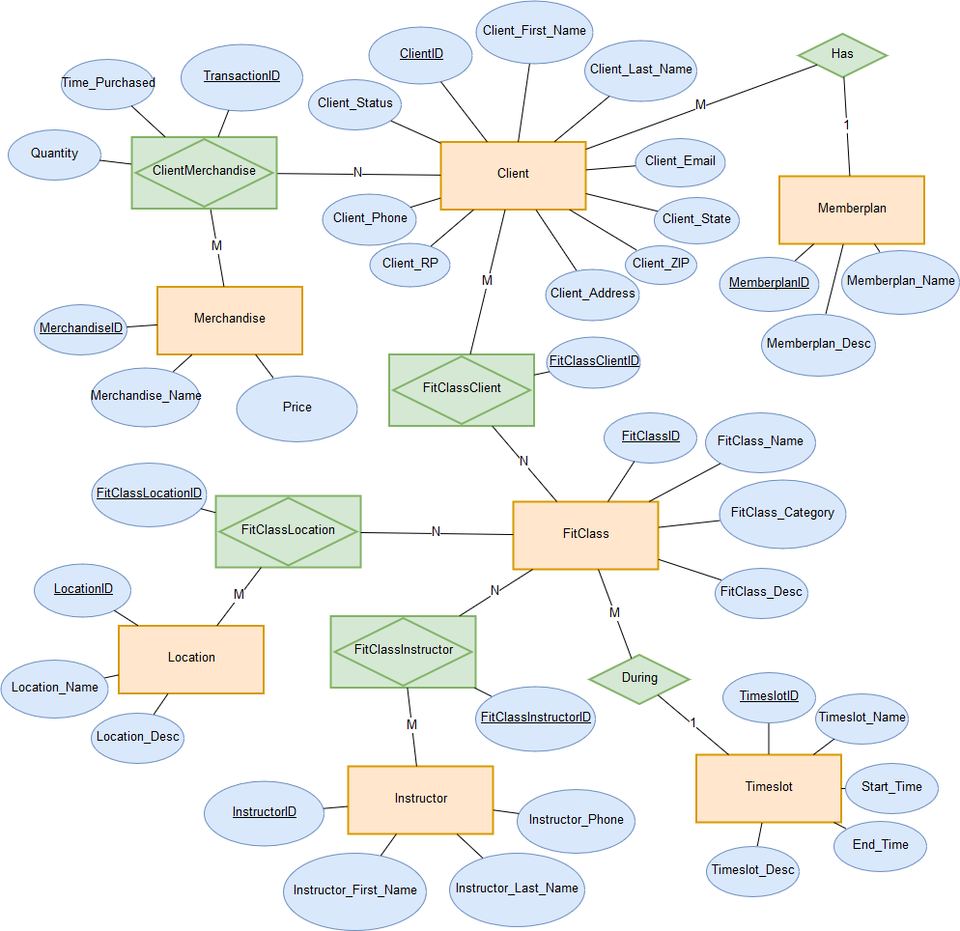
ER Diagram

Slide 5
Translation Method : Mapped
Relation Schema
Client (ClientID, MemberplanID*, Client_Status, Client_First_Name, Client_Last_Name, Client_Phone, Client_Address, Client_State, Client_ZIP, Client_Email, Client_RP)
Memberplan (MemberplanID, Memberplan_Name, Memberplan_Desc)
ClientMerchandise (TransactionID,ClientID*, MerchandiseID*, Time_Purchased, Quantity)
Merchandise (MerchandiseID, Merchandise_Name, Price)
FitClassClient (FitClassClientID,ClientID*, FitClassID*)
FitClass (FitClassID, TimeslotID*, FitClass_Name, FitClass_Category, FitClass_Desc)
Timeslot (TimeslotID, Timeslot_Name, Timeslot_Desc, Start_time, End_time)
FitClassLocation (FitClassLocationID, FitClassID*, LocationID*)
Location (LocationID*, Location_Name, Location_Desc)
FitClassInstructor (FitClassInstructorID,FitClassID*, InstructorID*)
Instructor (InstructorID, Instructor_First_Name, Instructor_Last_Name, Instructor_Phone)

Slide 6
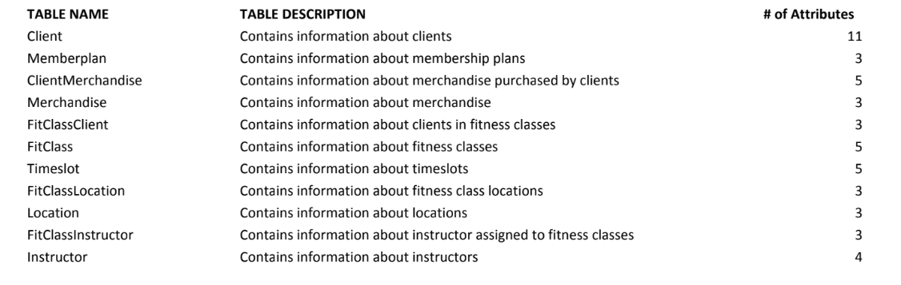
Data Dictionary

Slide 7
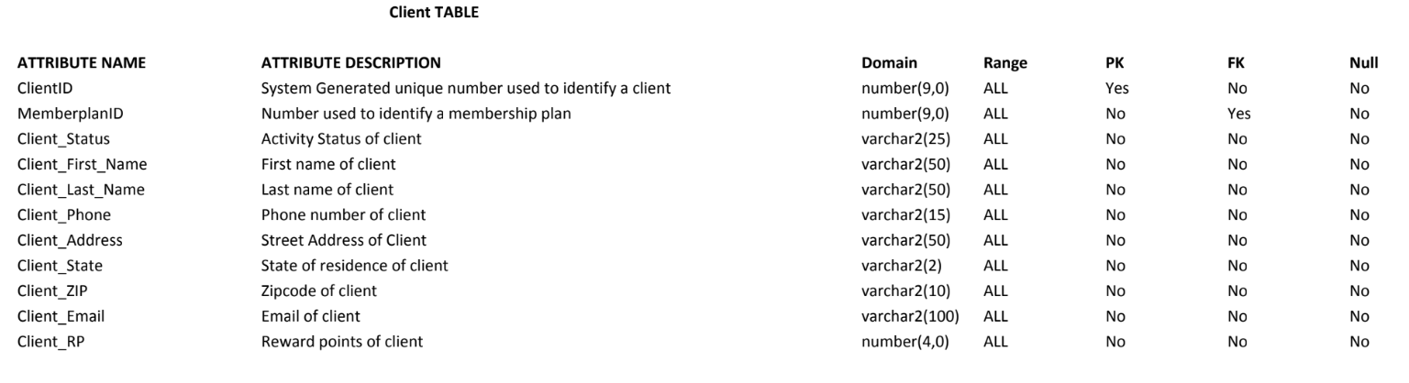
Data Dictionary

Slide 8
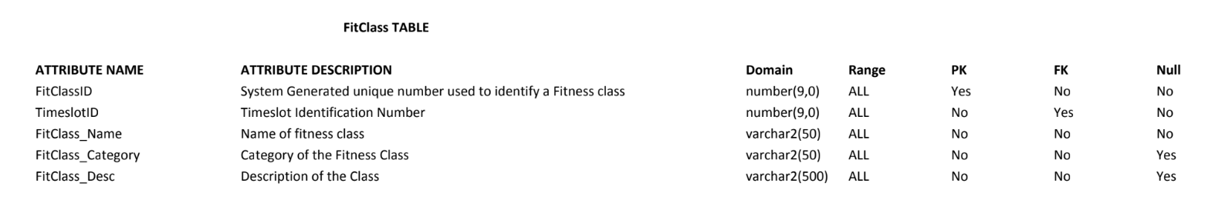
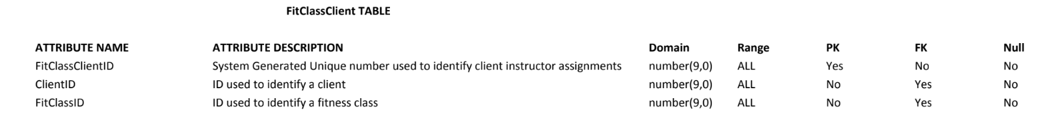
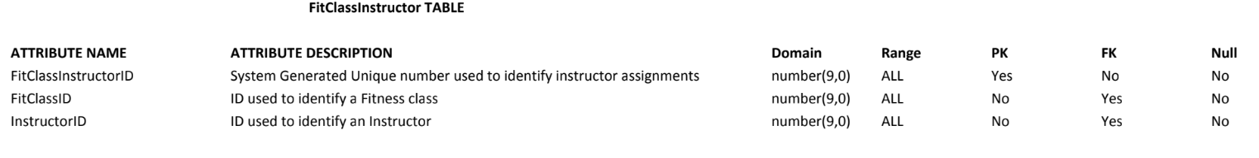
Data Dictionary

Slide 9
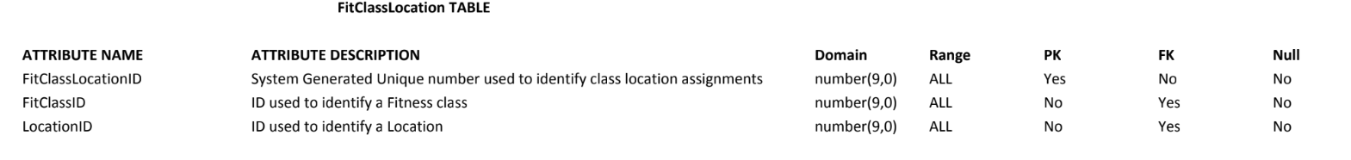
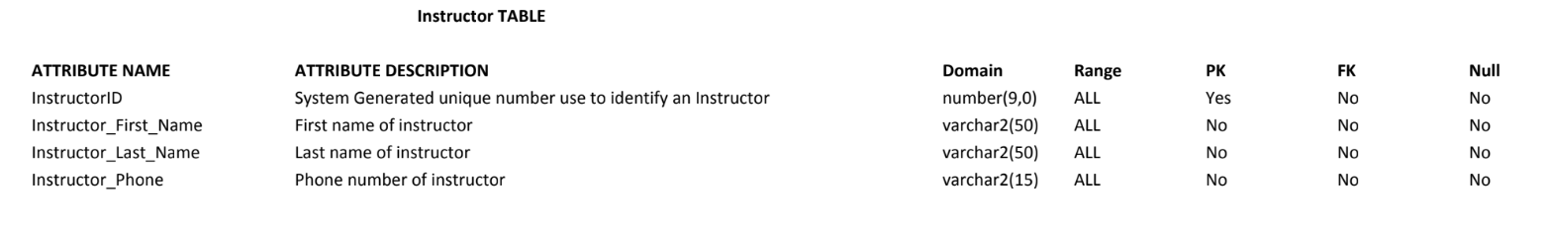
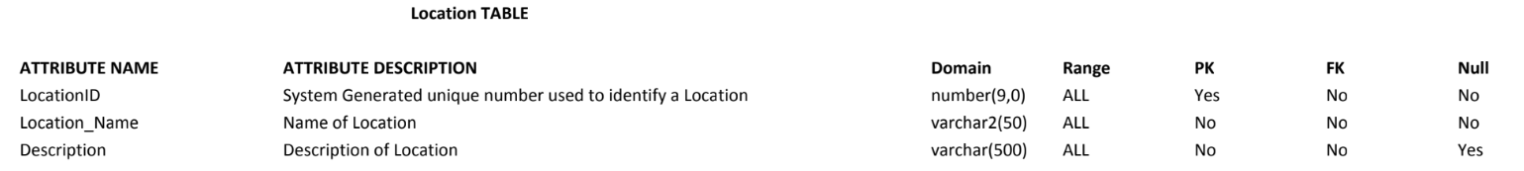
Data Dictionary

Slide 10
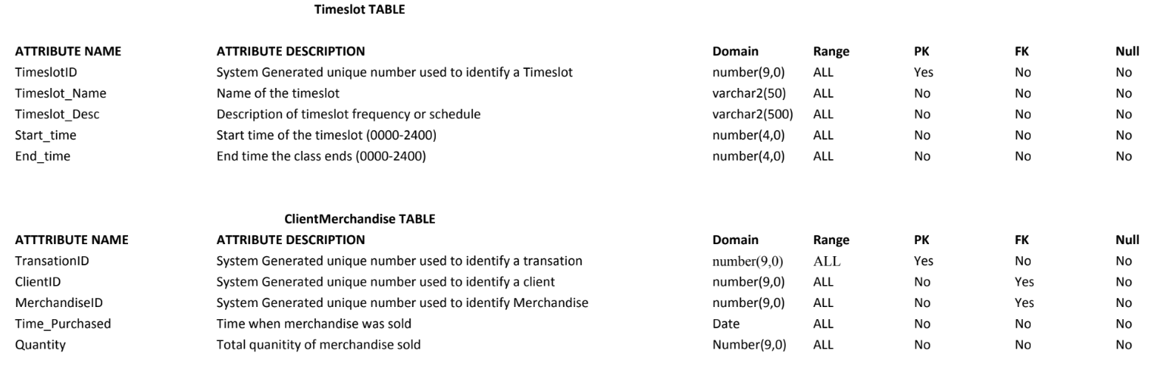
Data Dictionary

Slide 11
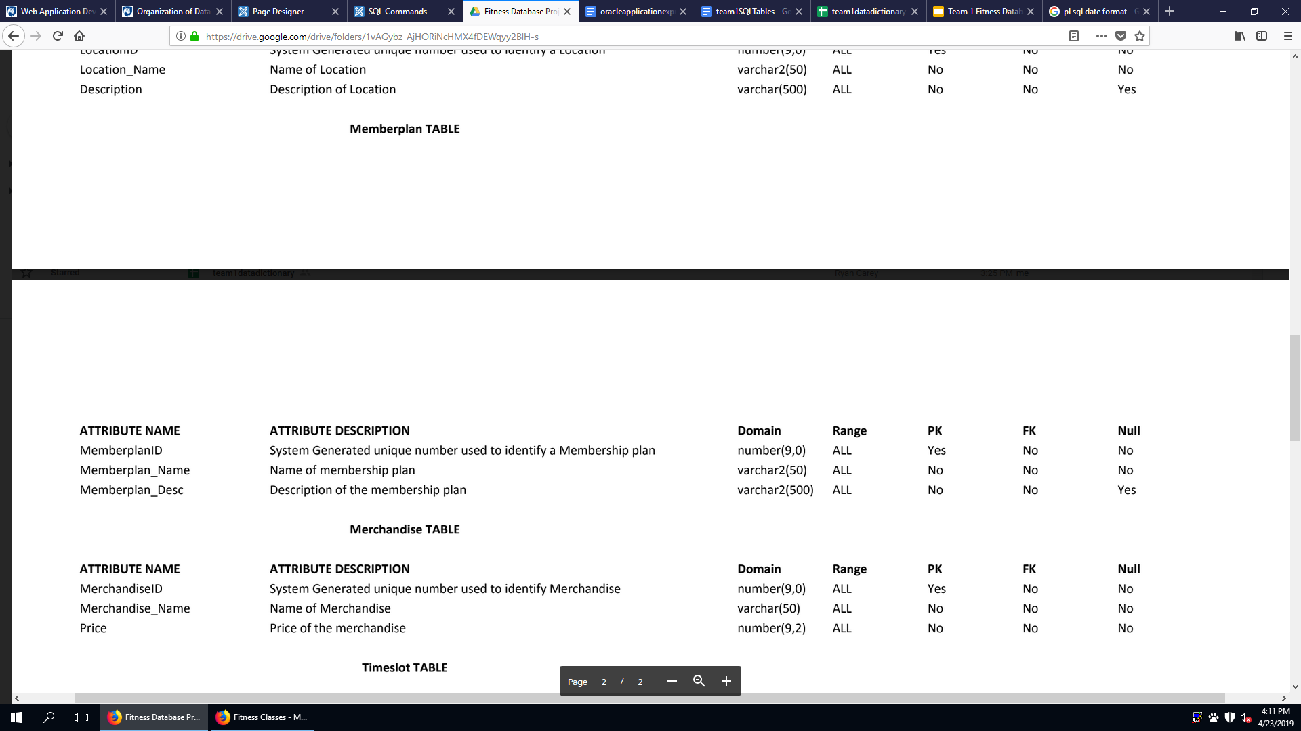
Data Dictionary

